Slide 1
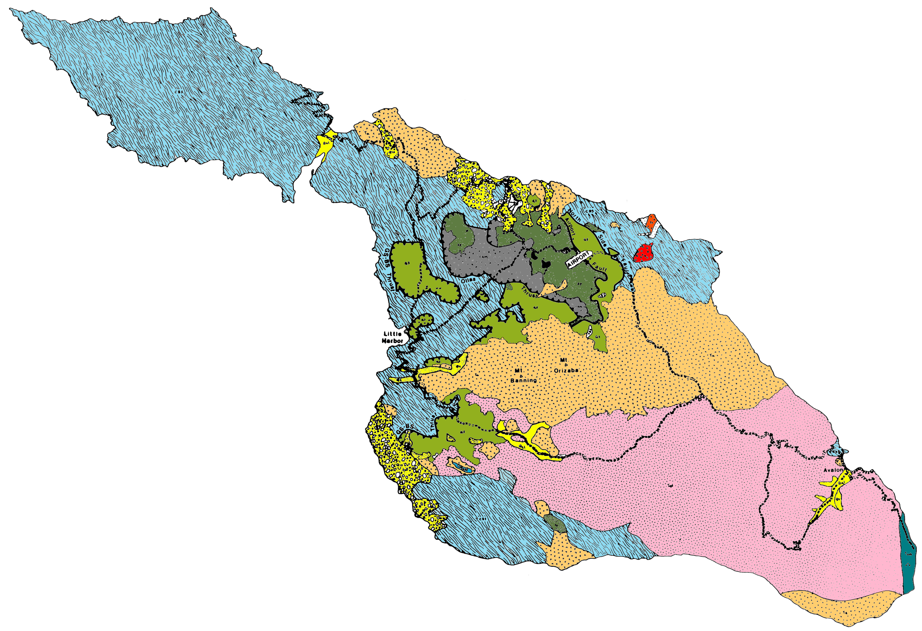
Geologic Overview
of Santa Catalina Island
Notes:
The various colors in this geologic map of Catalina Island show the distribution of different rock types. At first glance the arrangement of colors may look rather abstract and not particularly meaningful, but as we learn about the characteristics and origin of the various Catalina rocks in this lesson, an amazing story will unfold – the story of sea floor sediments caught between tectonic plates, shoved into the earth’s mantle, completely transformed by immense heat and pressure, folded, faulted, exhumed, eroded, intruded by magma, buried by submarine volcanics and sediments, and finally thrust above sea level and rotated 90 degrees clockwise. In order to better understand how Catalina formed let us first look at how it fits within the larger geological situation.

Slide 2
Catalina Island
Notes:
Catalina Island is part of a jumbled region of the earth’s crust ….

Slide 3
Continental Borderland
Notes:
… called the California Continental Borderland.

Slide 4
Pt. Conception
Vizcaino
Notes:
It extends from Pt. Conception in California to the Vizcaino Peninsula in Baja California.

Slide 5
Oceanic Crust
Continental Crust
Notes:
In most parts of the world the boundary between continental and oceanic crust is well defined, (like west of the Vizcaino Peninsula of Baja) …

Slide 6
Continental Borderland
Notes:
… but the continental borderland is a chaotic mishmash of continental crust fragments surrounded by discontinuous patches of crust which are not clearly continental or oceanic. The origin of this crustal nether world is extremely complex …

Slide 7
Peninsular Ranges
Notes:
but closely tied to that of the more easily understood Peninsular Ranges.
.

Slide 8
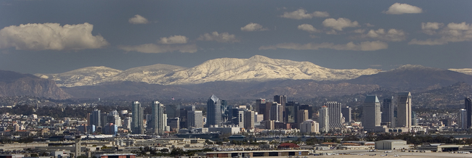
Notes:
Otherwise known as the Cuyamaca Mountains in San Diego County, the Peninsular Ranges’ relatively coherent geologic record, will help anchor our understanding of Catalina’s complex geologic history. Although the geologic history of southern California is long and complex, it can be simplified into four episodes easily remembered by the mnemonic …

Slide 9
 | EVENTS | ERA
T | Translation Transtension, Transpression Terracing | LATE CENOZOIC
U | Under-plating Uplift Un-roofing Undulating | EARLY CENOZOIC
M | Magmatic Madness Metamorphism | MESOZOIC
S | Stable Shelf Sedimentation | PALEOZOIC
Notes:
… “TUMS”. Or if you prefer to work forward in time, that becomes the decidedly spicier mnemonic …

Slide 10
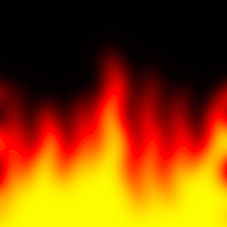
 | EVENTS | ERA
 | Translation Transtension, Transpression Terracing | LATE CENOZOIC
 | Under-plating Uplift Un-roofing Undulating | EARLY CENOZOIC
 | Magmatic Madness Metamorphism | MESOZOIC
 | Stable Shelf Sedimentation | PALEOZOIC
T
U
M
S
Notes:
… SMUT!

Slide 11
 | EVENTS | ERA
 | Translation Transtension, Transpression Terracing | LATE CENOZOIC
 | Under-plating Uplift Un-roofing Undulating | EARLY CENOZOIC
 | Magmatic Madness Metamorphism | MESOZOIC
 | Stable Shelf Sedimentation | PALEOZOIC
T
U
M
S
Notes:
In either case the oldest era, the Paleozoic, is represented by the “S” which stands for Stable Shelf Sedimentation…

Slide 12
ARIZONA
SAN DIEGO
Stable Continental
Crust (craton)
Limestone
Ocean Crust
Notes:
… which means that during the Paleozoic Era (~540-250mya) the western margin of North America was fairly stable (little mountain building) so sediments like sand, mud and lime slowly accumulated along the continental shelf and slope. What would later become San Diego and the rest of the California Continental Borderland lay a few hundred kilometers offshore in deep water. No rock record from this period exist anywhere in the Continental Borderland because those deep water sediments were deposited on oceanic crust which was completely subducted during the second era of our story …

Slide 13
 | EVENTS | ERA
 | Translation Transtension, Transpression Terracing | LATE CENOZOIC
 | Under-plating Uplift Un-roofing Undulating | EARLY CENOZOIC
 | Magmatic Madness Metamorphism | MESOZOIC
 | Stable Shelf Sedimentation | PALEOZOIC
T
U
M
S
Notes:
… the mighty Mesozoic. The “M” in our mnemonic here not only reminds us of the Mesozoic Era (~250-65mya), but also the massive quantities of magma generated by subduction and the associated metamorphism.

Slide 14
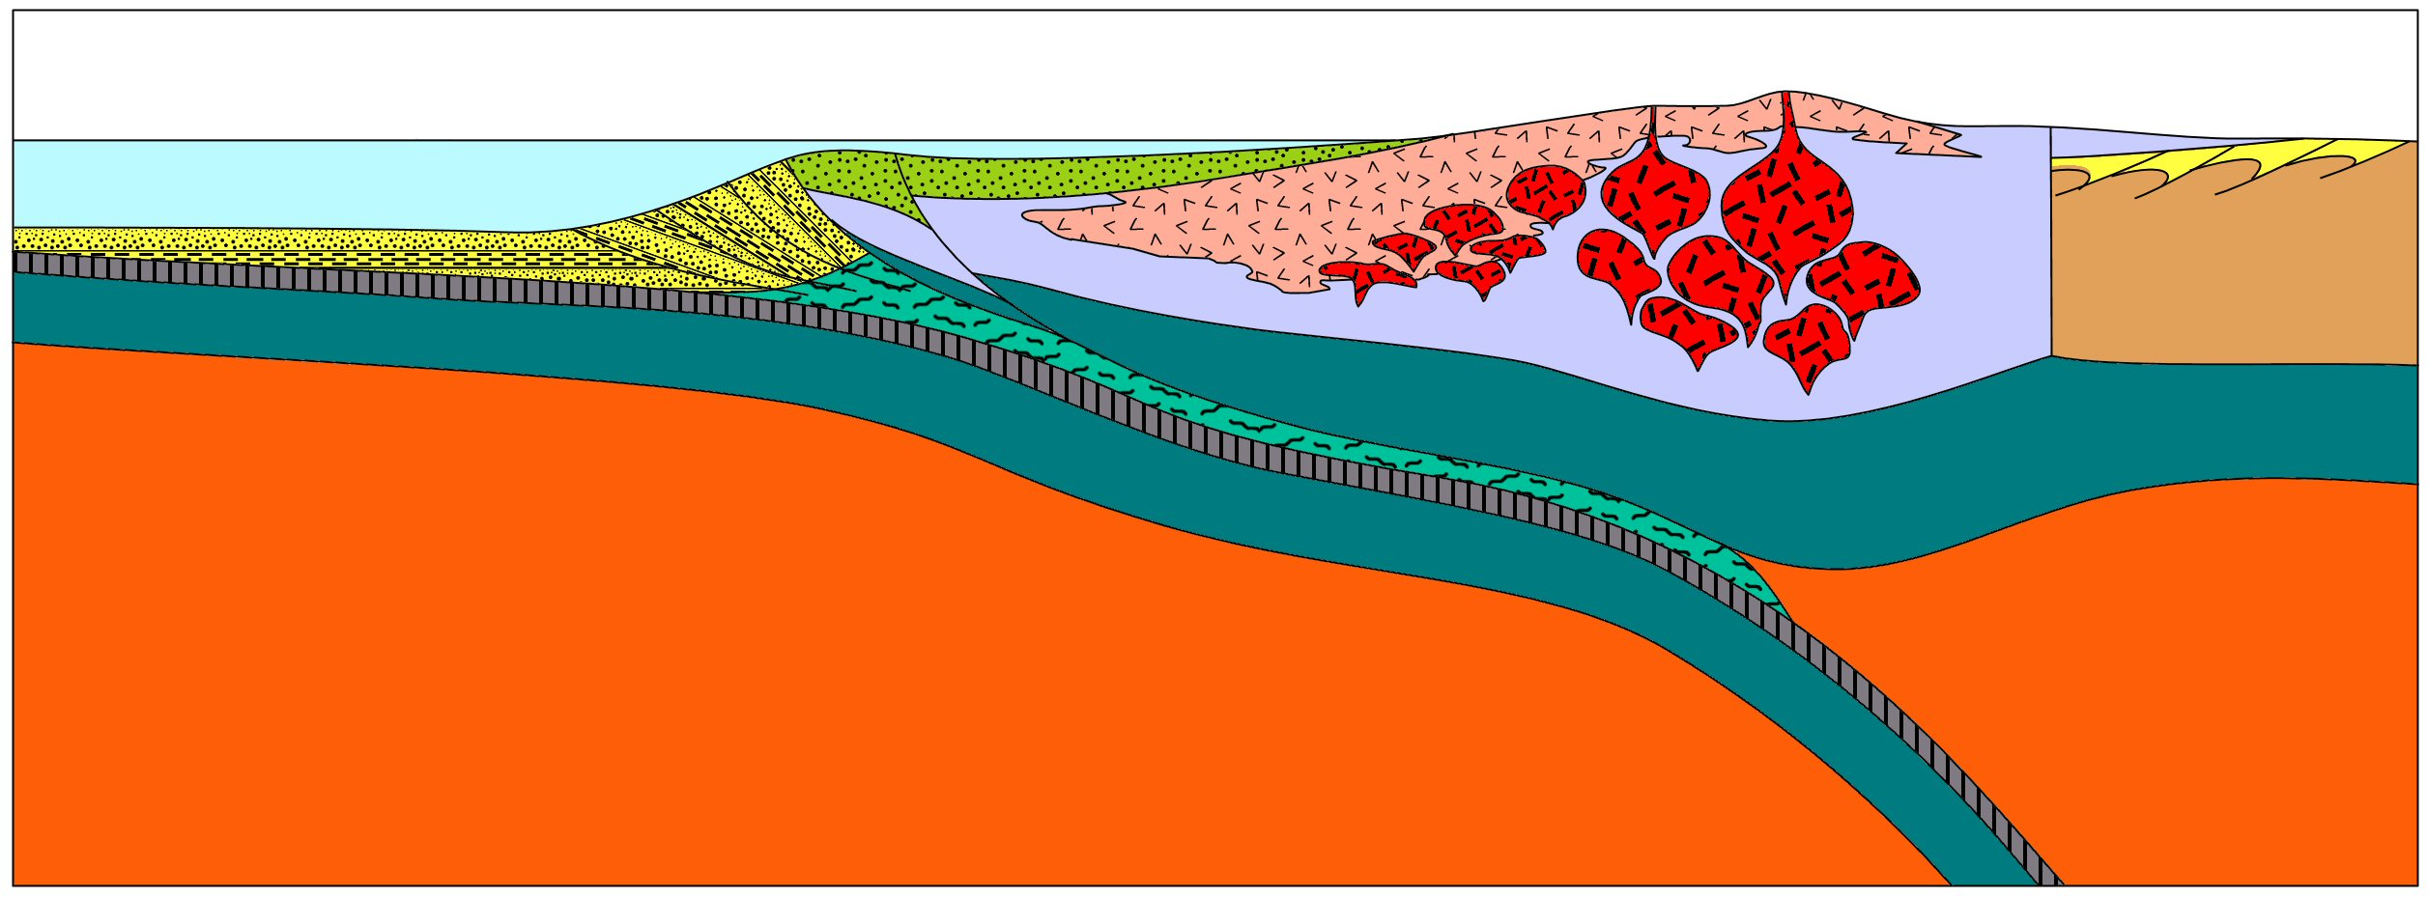
Volcanic Arc
Craton
Farallon Plate
North American Plate
Notes:
During the Mesozoic the Farallon Plate subducted under the western margin of the North American Plate. The resulting magma cooled and solidified into both near-surface volcanic igneous rocks and deep-seated plutonic igneous rocks. These igneous rocks are now exposed throughout the Peninsular Ranges, while a pile of scraped-off sediments accumulated near the trench.

Slide 15
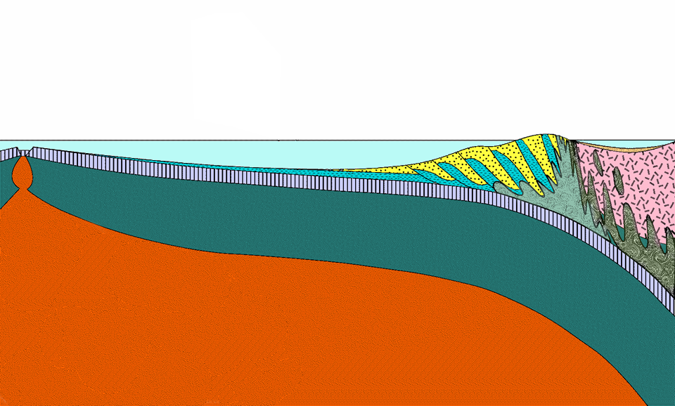
?
Notes:
Let’s take a closer look at this region since it is the environment where most of the rocks on Catalina Island were formed. First let’s see if you can identify the tectonic components here. If this represents the Mesozoic California Continental Borderland, what plate is represented by the pink rocks?

Slide 16
North American Plate
Notes:
Yah, it’s the North American Plate. Now for a little harder question:

Slide 17
North American Plate
?
Notes:
What plate is subducting beneath it?

Slide 18
North American Plate
Farallon Plate
Notes:
Yep, it’s the Farallon Plate.

Slide 19
North American Plate
Farallon Plate
?
Notes:
Now what plate would border the Farallon Plate to the west?

Slide 20
North American Plate
Farallon Plate
Pacific Plate
Notes:
If you picked the Pacific Plate then you probably have some geological background.

Slide 21
North American Plate
?
Farallon Plate
Pacific Plate
Notes:
OK, now what sea floor feature marks the boundary between the Pacific and Farallon Plates?

Slide 22
North American Plate
East Pacific Rise
Farallon Plate
Pacific Plate
Notes:
Yes, it’s the East Pacific Rise …

Slide 23
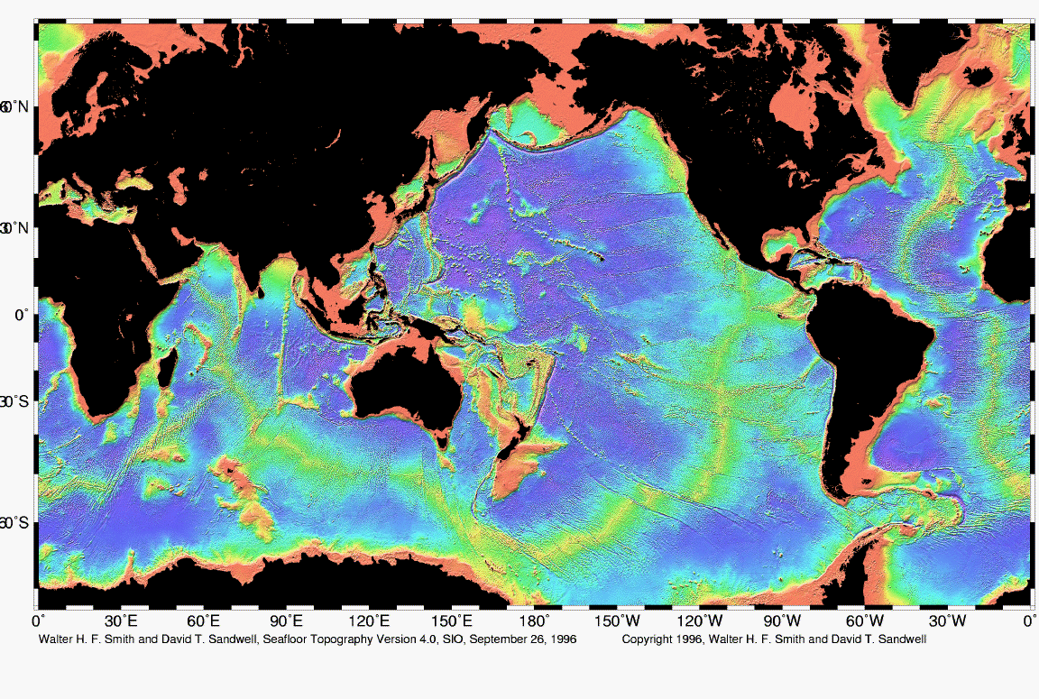
East Pacific Rise
Notes:
… the broad sea floor mountain range extending from the South Pacific into the Gulf of California.

Slide 24
North American Plate
?
East Pacific Rise
Farallon Plate
Pacific Plate
Notes:
What about this basin?

Slide 25
North American Plate
Forearc Basin
East Pacific Rise
Farallon Plate
Pacific Plate
Notes:
Did you pick forearc basin?

Slide 26
North American Plate
Forearc Basin
East Pacific Rise
Farallon Plate
Pacific Plate
?
Notes:
Now what about the orange layer just below the plates?

Slide 27
North American Plate
Forearc Basin
East Pacific Rise
Farallon Plate
Pacific Plate
Asthenosphere
Notes:
That’s the mushy asthenosphere where magma is likely to form.

Slide 28
North American Plate
Forearc Basin
East Pacific Rise
?
Farallon Plate
Pacific Plate
Asthenosphere
Notes:
What do you call this tectonic feature that’s comprised of sea floor sediments scraped off the subducted plate?

Slide 29
North American Plate
Forearc Basin
East Pacific Rise
Accretionary Wedge
Farallon Plate
Pacific Plate
Asthenosphere
Notes:
Yes! That’s an accretionary wedge, and as we shall soon see, the major player in the geologic story of Catalina. In my vernacular …

Slide 30
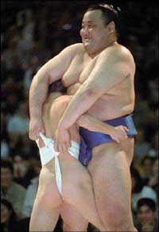
Accretionary Wedgie
Notes:
… accretionary “wedgie” is perfectly acceptable (if not encouraged)!

Slide 31
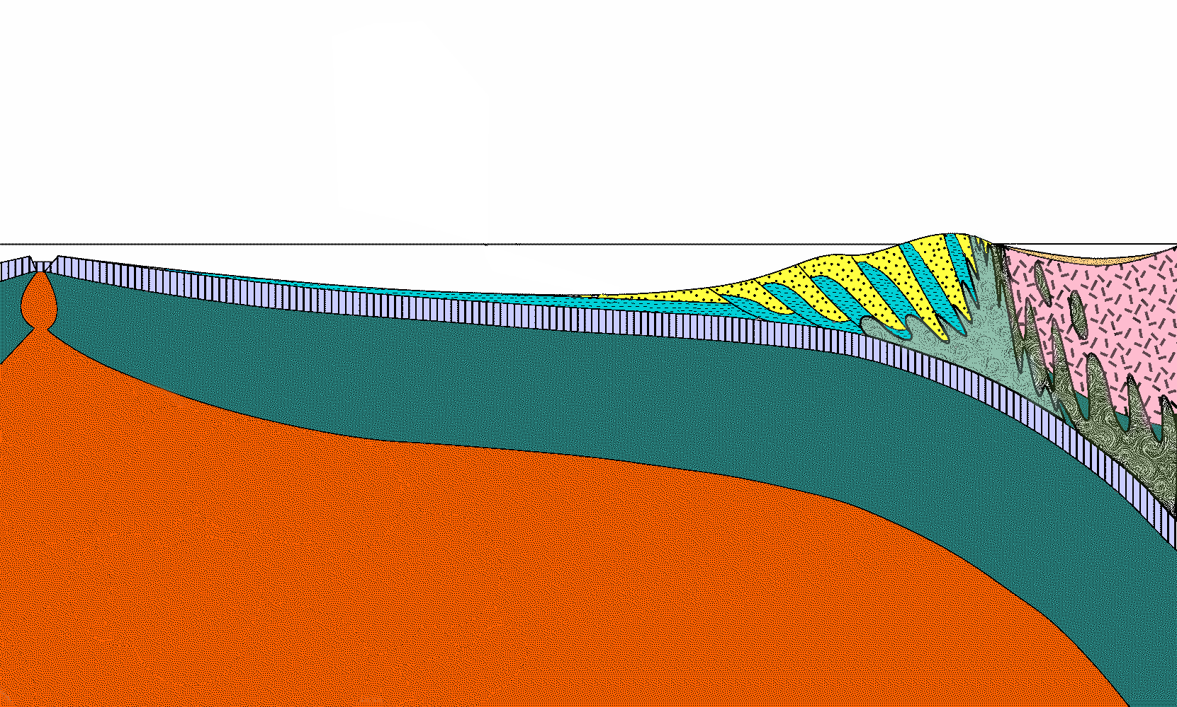
Accretionary Wedgie
Notes:
With that in mind let’s examine the accretionary “wedgie” more closely since most of Catalina’s rocks were formed in this environment.

Slide 32
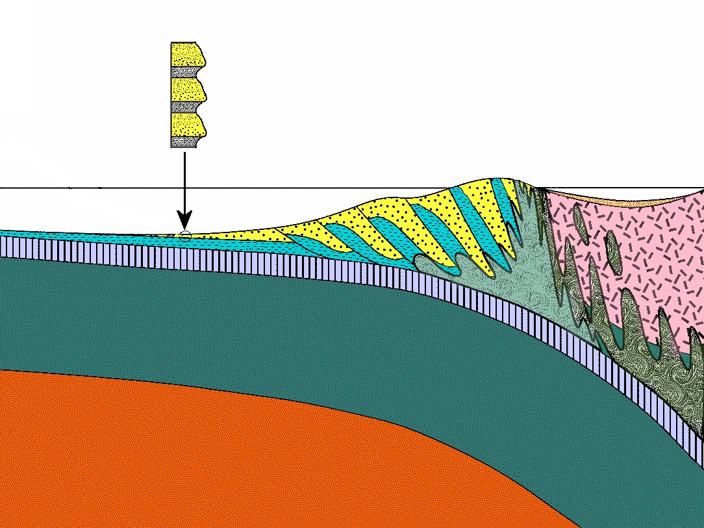
Klamath?
Mélange
Notes:
Most of the sediments that were scraped from the sea floor to form the wedge are layered such that particles become smaller towards the top of a layer.

Slide 33
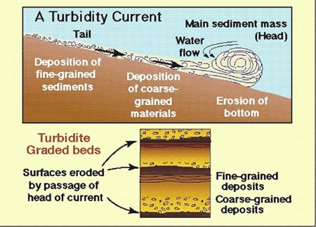
Notes:
That pattern is called graded bedding and is typical of “turbidite” – the sediment type deposited by turbidity currents. Turbidity currents are generally fast-moving mixtures of sand, mud and water that are propelled down underwater slopes by their greater density relative to sea water. Each layer within a turbidite sequence represents the deposits of one turbidity current event during which time the coarser sand settles before the finer mud. Such events may be 10’s to hundreds of years apart, so there is ample time for very fine particles to settle out as well as other types of sediment like plankton shells and dust to accumulate.

Slide 34
Turbidite
Klamath?
Mélange
Notes:
Turbidite is the dominant sediment type accreted to the wedge.

Slide 35
Turbidite
turbidity current
Klamath?
Mélange
Notes:
In Catalina’s case it was deposited by turbidity currents which tumbled into deep water down the relatively steep slope of the wedge. Such currents can travel out to sea for hundreds of kilometers …

Slide 36
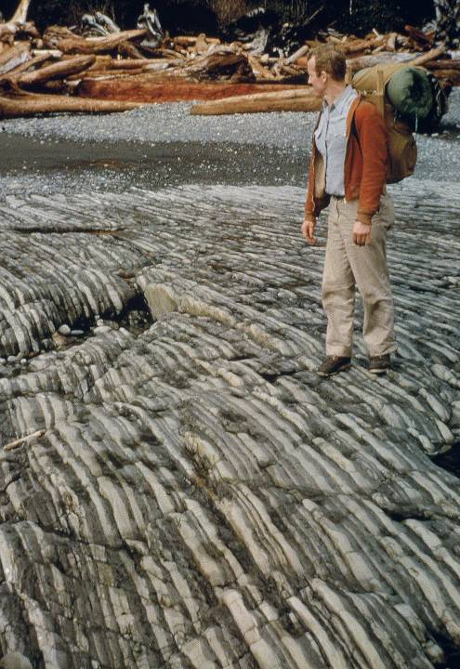
Notes:
… where they deposit thinly bedded turbidite like these in Olympic National Park, Washington.

Slide 37
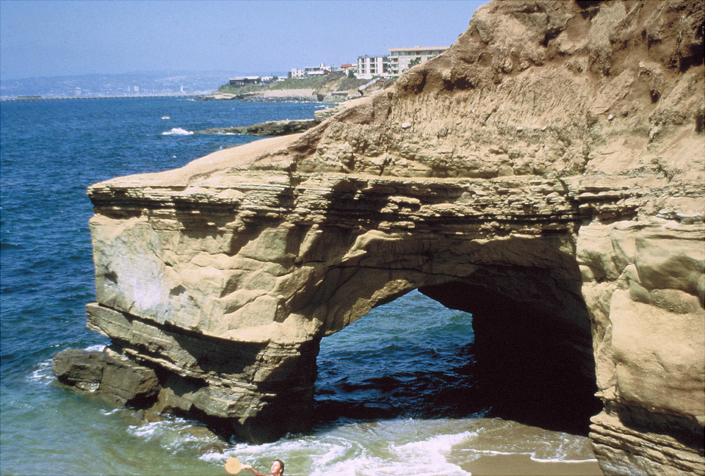
Notes:
When turbidite deposits closer to land, the layers are much thicker like these at Sunset Cliffs, CA.

Slide 38
Shale
Sandstone
Shale
Notes:
In either case the sand layers harden into sandstone and the mud into shale.

Slide 39
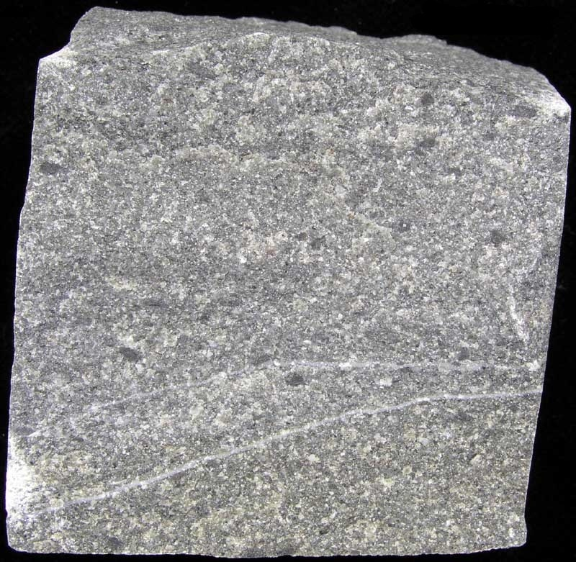
Greywacke
Notes:
Because turbidity currents churn-up a variety of particle sizes, turbidite sandstone generally contains a fair amount of silt and clay as well as sand. Such sandstone goes by the somewhat whimsical name - “greywacke”.

Slide 40
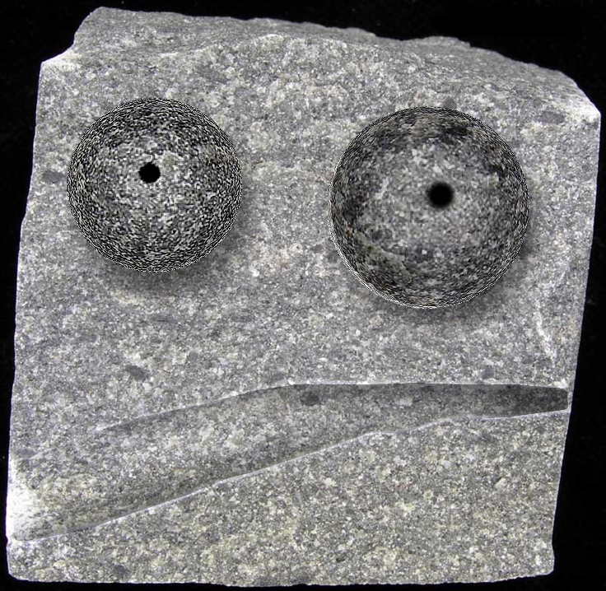
Greywacke
Notes:
Surprisingly the “wacke” part has nothing to do with this rock’s legendary ability to transform itself into silly faces. It merely means “earthy rock” in German. The typically grey color derives from light-colored minerals like quartz and feldspar mixed with darker rock fragments.

Slide 41
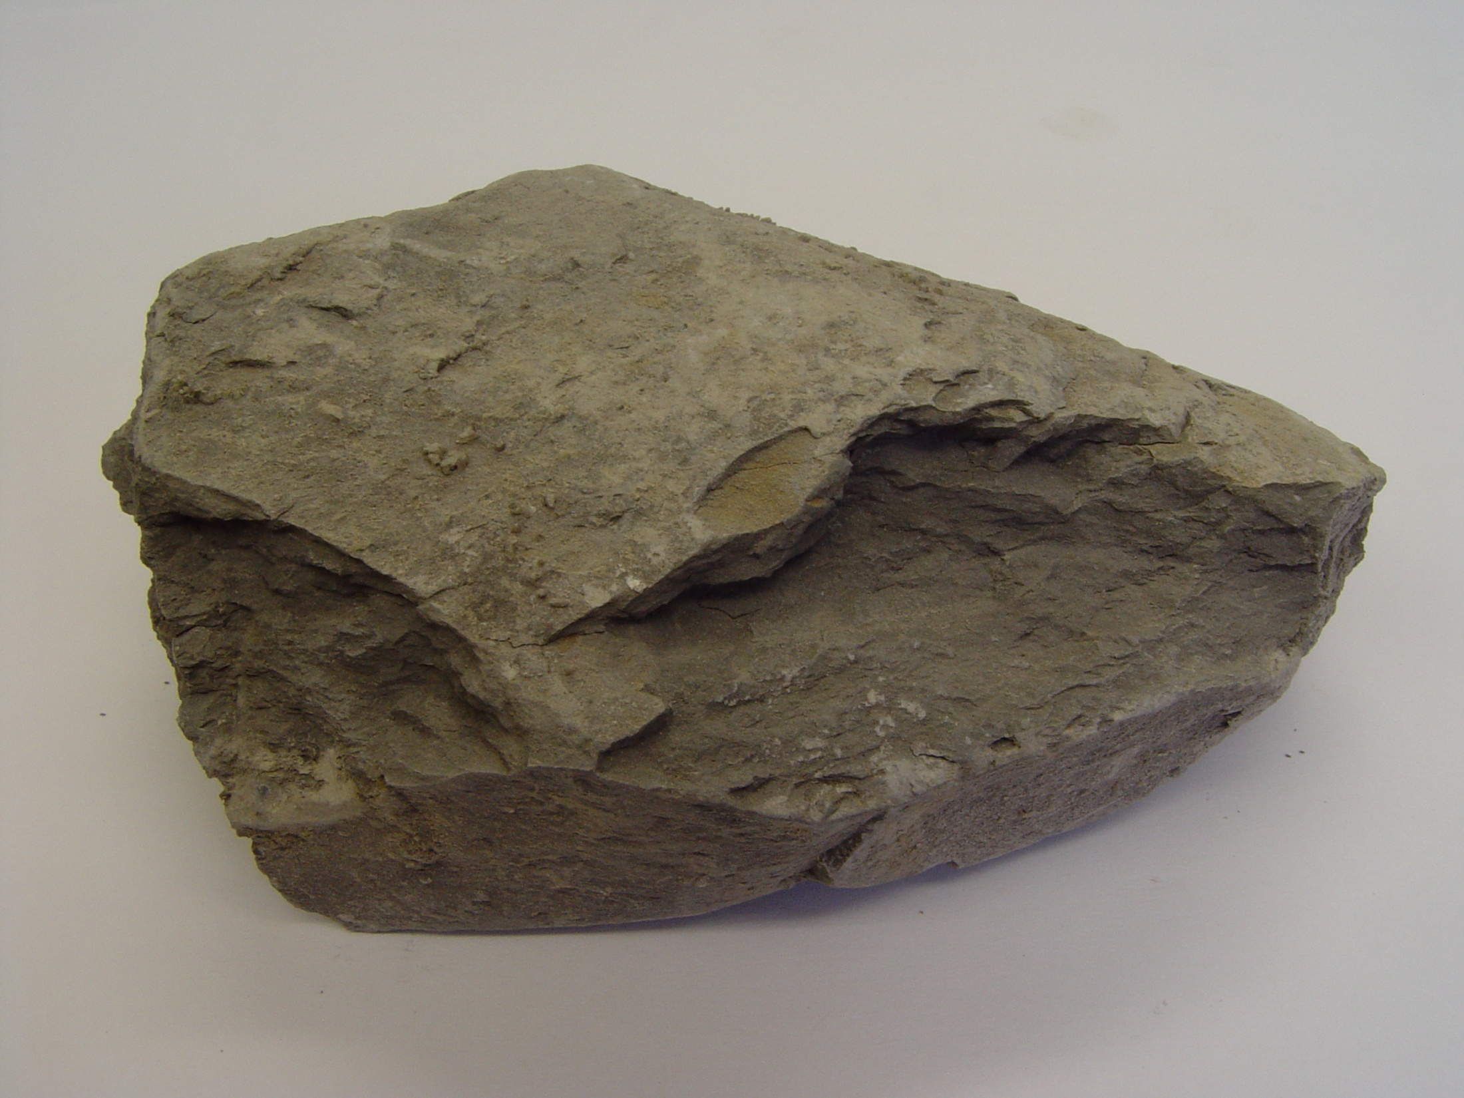
Shale
Notes:
Shale is also commonly grey, but in this case from light colored silt and clay mixed with dark colored organic matter.

Slide 42
Catalina Turbidite
Shale Greywacke
Notes:
Catalina turbidites are disproportionately greywacke rich. In fact they contain almost no shale – a fact suggesting that uplift of the wedge was so rapid that very little time lapsed between turbidite events to allow for the deposition of shale.

Slide 43
Wedgie composition
Turbidite (overwhelmingly greywacke)
Notes:
So greywacke is the dominant rock type comprising the Catalina accretionary wedge.

